Slide 1


TEXT SUMMARIZATION - STUFF
MOHAMED NAJI ABOO
Notes:
https://unsplash.com/photos/curtain-wall-building-under-white-sky-nHdTXaUSbM8

Slide 2
Text Summarization
Stuff - which simply concatenates documents into a prompt;
Map Reduce - Summarize each document on its own in a "map" step and then "reduce" the summaries into a final summary
Notes:
https://unsplash.com/photos/architectural-photography-of-glass-building-Ub9LkIWxyec

Slide 3
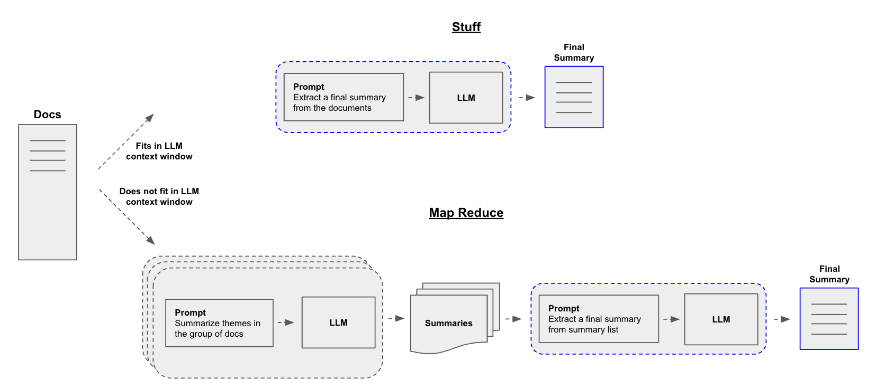
Notes:
https://unsplash.com/photos/architectural-photography-of-glass-building-Ub9LkIWxyec

Slide 4
Thanks
Notes:
You can safely remove this slide. This slide design was provided by SlideModel.com – You can download more templates, shapes and elements for PowerPoint from http://slidemodel.com

